Slide 1


Learn SQL from Scratch
Ginger Burton
9/26/2018

Slide 2
Example Table of Contents
Table of Contents
01
02
03
What is the user journey?
How many first touches is each campaign responsible for?
How many last touches is each campaign responsible for?
How many visitors make a purchase?
How many last touches on the purchase page is each campaign responsible for?
What is the typical user journey?
Optimize the campaign budget.
Get Familiar with the company.
How many campaigns and sources does CoolTShirts use and how are they related? Be sure to explain the difference between utm_campaign and utm_source.
What pages are on their website?
CoolTShirts can re-invest in 5 campaigns. Which should they pick and why?

Slide 3
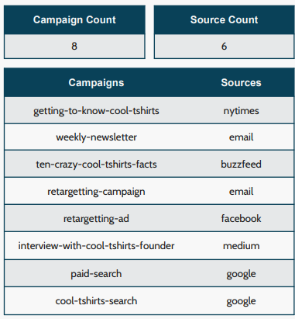
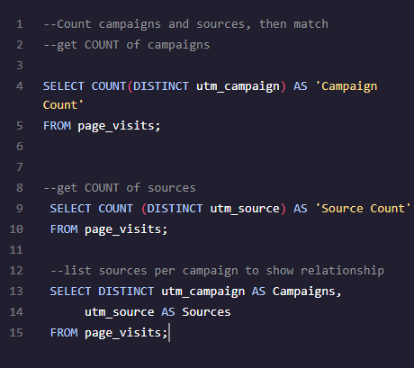
Get Familiar with CoolTShirts
How many campaigns and sources does CoolTShirts use? Which source is used for each campaign?
A source is the type of communication such as email, or site on which a campaign is
shared with prospective customers, like
Google or Facebook.
A campaign is a specific message designed
to elicit a specific response from a specific
group of prospective customers.
A source, like email, can run multiple
campaigns, like 'retargeting' or 'weekly
newsletter’.
The same campaign could be run across
multiple sources, although that is not
represented in this dataset.

Slide 4
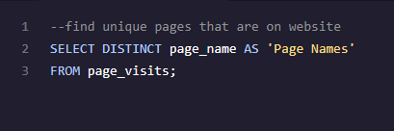
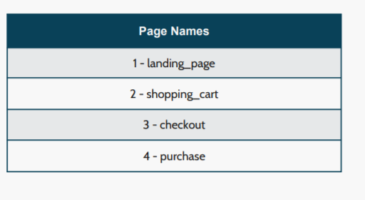
Get Familiar with CoolTShirts
What pages are on their website?
If we find the distinct values of the page_name column,
using a simple SELECT DISTINCT query. This returns the
unique web pages that are a part of the overall website.

Slide 5
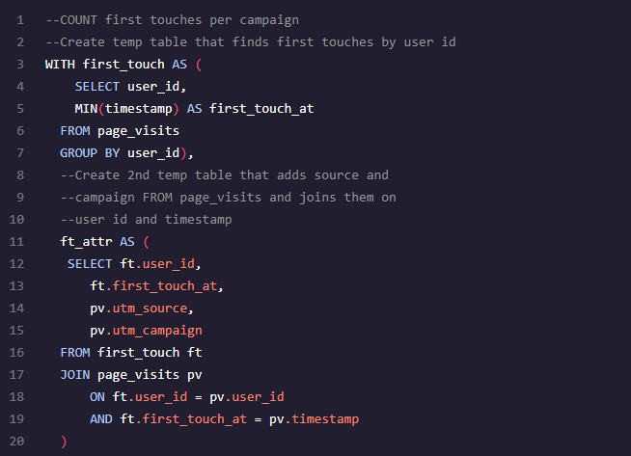
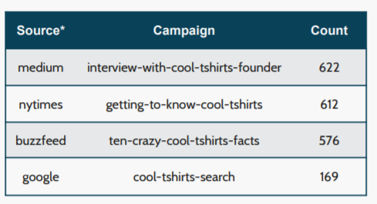
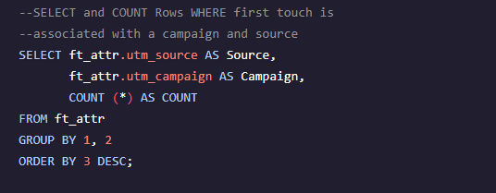
What is the User Journey?
How many first touches is each campaign responsible for?
Searching the timestamps with the MIN date for each user, we can determine which source and campaign first captured the prospects attention and prompted the click through.

Slide 6
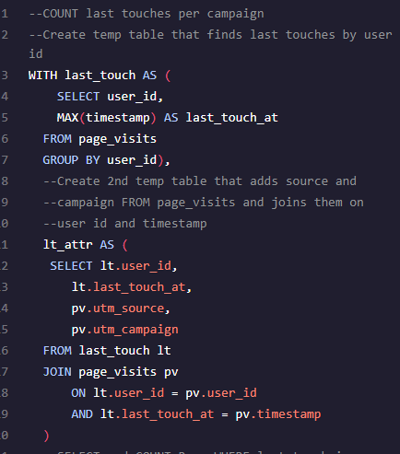
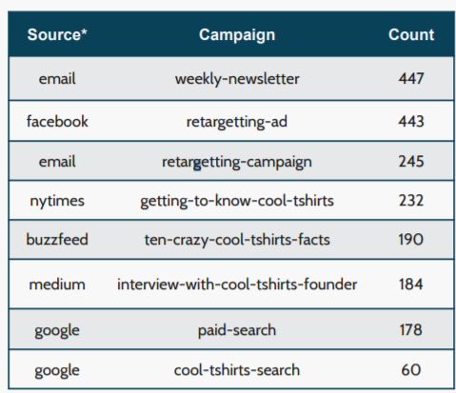
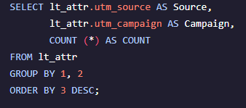
What is the User Journey?
How many last touches is each campaign responsible for?
Timestamps with the MAX date for each user show which source and campaign was responsible for driving prospects that visited the site based on last touch.

Slide 7
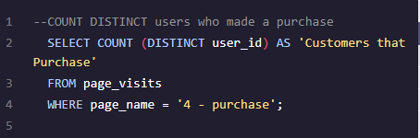
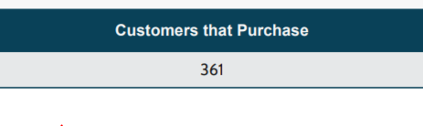
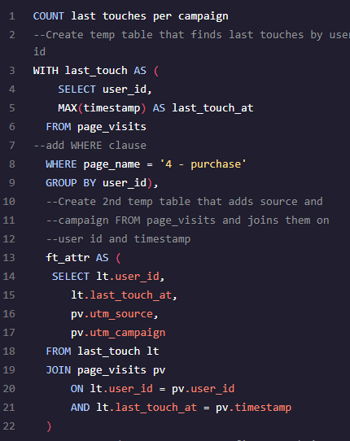
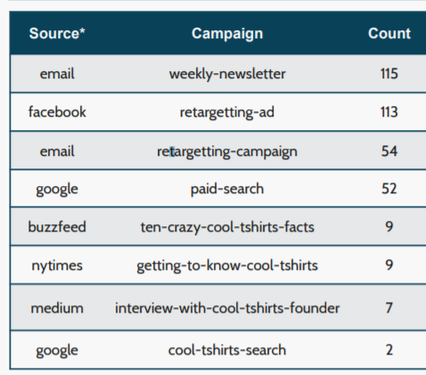
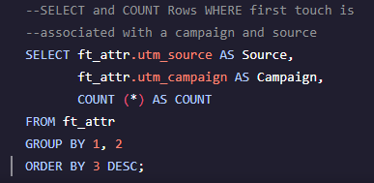
What is the User Journey?
How many visitors make a purchase?
Conversion rate from visitor to customer, is 18% (361/1979=18)
How many last touches on the purchase page is each campaign responsible for?
Searching MAX timestamp where purchase page is specified as the page visited, we can see the sources and campaigns responsible for conversion.

Slide 8
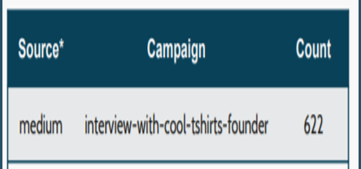
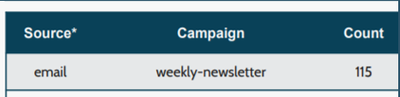

What is the User Journey?
What is the typical user journey?
The majority of prospective customers are drawn to the site by the medium source with campaign interview-with-cool-tshirts-founder. Although, this doesn’t necessarily lead to a purchase.
The email source campaign weekly-newsletter has the most last touches and seem to be the majority of purchases thus far.
Total purchases= 361
From weekly newsletter= 115
115/361= 32%

Slide 9
Which five campaigns should CoolTShirts re-invest in?
We can see that the campaigns “getting to know cool tshirts” and “interview with the cooltshirts founder” make up the majority of first touches, leading prospects to the site initially.

Slide 10
Which five campaigns should CoolTShirts re-invest in?
Looking at last touches, it’s clear that “re-targeting ads” are getting the majority of last touches from prospects.

Slide 11
Which five campaigns should CoolTShirts re-invest in?
Based on the data gathered, it is recommended to reinvest in those that translate to the most purchases since revenue is the goal.
It is clear that the weekly newsletter, re-targeting ad, re-targeting campaign, and paid search garner the majority of purchases. The remainder aren’t far from each other in purchase count but getting to know cool tshirts has more first and last touches so that should be included.

